Slide 1

Abuse Detection
in Ao3 comments
Notes:
Hello everyone! Today I’ll be presenting my capstone project: abuse detection in Ao3 comments.

Slide 2
Problem Statement
1
Data Collection & Cleaning
2
Exploratory Data Analysis
3
Modelling & Model Evaluation
4
Conclusions & Recommendations
5

Slide 3




Problem statement
Search
WHAT IS AO3?
WHO CARES ABOUT FANFIC?
Ao3 is a nonprofit, open-source archive for fanfiction
Fanfiction is primarily written and consumed by queer women and genderqueer folks
40 million+ daily visits
7 million+ works
4 million+ users
Fanfiction is fiction written in an amateur capacity by fans, based on existing works of fiction

Slide 4

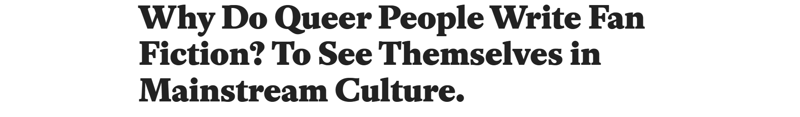
The history of queer representation is one long yellow brick road of insulting punchlines. Queer characters are traditionally relegated to secondary status and... if a queer person ever does get a shot at the spotlight, they often fall victim to a host of unfortunate tropes that are as insulting as they are tired and overdone.
For many queer viewers, favorite movies and TV shows offer a world in which complex, dynamic, actively queer people—people like them—do not exist.
Fanfiction is one of the few outlets that an increasingly frustrated queer audience has to engage with material that refuses to engage with them. It represents a challenge to the notion that being created in a straight world means one must live a straight life... It represents a refusal to be punchlines anymore, a refusal to express ourselves less because it’s more convenient for everyone else.
In writing fanfiction, we do more than rewrite our favorite stories. We take those stories and make them strong enough to handle people like us.

Slide 5
Problem statement
Search
WHAT IS AO3?
WHY CARE ABOUT FANFIC?
Ao3 is a nonprofit, open-source archive for fanfiction
Fanfiction is a crucial form of expression and representation for marginalized communities
40 million+ daily visits
7 million+ works
4 million+ users
Online communities based around fanfiction are safe havens for marginalized individuals to meet, mingle, and bond over fan content
Fanfiction is fiction written in an amateur capacity by fans, based on existing works of fiction

Slide 6
Problem statement
Search
CHALLENGES
BIRTH OF AO3
CRITICISMS
Censorship by webhosts
Livejournal Strikethrough
Fanfiction.net’s R ban
Tumblr’s NSFW ban
Established specially for hosting fanfiction
Abuse & harassment
Lack of features to block harassment & hate speech
Turn off anon comments
Comment moderation
Anti-censorship
Legal threats
The Anne Rice crackdown on fanfic authors in 2000
Legal advocacy
Racism
Racist trolling
Racist harassment of Ao3 authors of colour
Notes:
Fanfiction communities have been met with numerous challenges in the past. The first challenge is the issue of censorship by webhosts. A second major challenge is the issue of legal threats from copyright holders, most famously Anne Rice (author of the Vampire Chronicles) and her crackdown on fanfiction authors in 2000 which involved her not just sending threatening legal letters, but also cyberstalking, doxxing, and harassing them even after they had removed their fanfiction.
Ao3 was created specifically to address these challenges. Ao3 was started with the specific purpose of hosting fanfiction. Their anti-censorship stance was a direct response to censorship crackdowns that affected fanfiction communities on other sites. At the same time, Ao3 also invests in and supports legal advocacy for fanfiction communities, which includes legal advocacy for fans who may come under threat from authors like Anne Rice.
More recently, Ao3 has begun to come under serious fire in more recent years for slow response to issues of abuse and harassment on its platform. There is still a lack of protective features against harassment. Although authors CAN turn off anonymous commenting, should authors continue to be targeted by registered troll accounts, their only next option is to turn on comment moderation. However, in comment moderation mode, all comments must be approved by the author before they become visible to readers. It thus fails to protect the author, who must still sift through the abusive content.
Authors of colour are especially vulnerable to racist trolling and hate speech. Criticisms against Ao3’s handling of racist harassment came to a peak in the last two years, coinciding with the peak of the BLM movement, culminating in the publishing of an open letter in 2020, which called for changes to Ao3’s technological structures and abuse policies that specifically address racist content and racist trolling.

Slide 7
Problem statement
Search
My goal is to build a text classification model that can flag abusive comments. If successful, this model could serve as proof of concept for an “automated comment moderation” function, which could be used to:
automatically filter abusive comments into a separate inbox
flag trolls and hateful accounts to the Abuse Team
Hateful speech and online abuse is a serious issue
30% of polled users have been harassed by commenters on Ao3
Who is going to do the moderation? Ao3 is run by volunteers.

Slide 8
Problem Statement
1
Data Collection & Cleaning
2
Exploratory Data Analysis
3
Modelling & Model Evaluation
4
Conclusions & Recommendations
5

Slide 9
Data collection
Search
KEY CHALLENGE
Lack of a large and diverse enough dataset of hateful and abusive Ao3 comments
TRAINING DATASET
100,000 Wikipedia discussion comments rated for toxicity (1–5), aggression (1-7), and whether the comment contained a personal attack (0 or 1)
Due to imbalanced classes, the non-abusive class was undersampled, leaving 15,000 comments with an even 50% split
FINAL TEST DATASET
320 Ao3 comments, 50% of which were flagged as abusive
Comments were sourced from social media posts about trolls in a specific fan community
Two datasets of abusive comments
Several documents containing pictures of comments from known trolls
Pictures of comments posted directly to Twitter
Notes:
One of the key issues that limit the development of machine learning in this area, is the lack of sufficient labelled data necessary to train a model. As such, a key choice that I had to make early on was to use a different dataset for training and validation, before the model is ultimately tested on actual Ao3 comments.
Test data was comprised of 320 Ao3 comments which I manually compiled and labelled. The abusive comments were obtained by searching the names of four trolls known to comment on fanfiction of a popular Chinese drama. By searching their names, I found two datasets of abusive comments for one troll, several documents containing screenshots from other known trolls, and also many screenshots posted directly to Twitter.

Slide 10

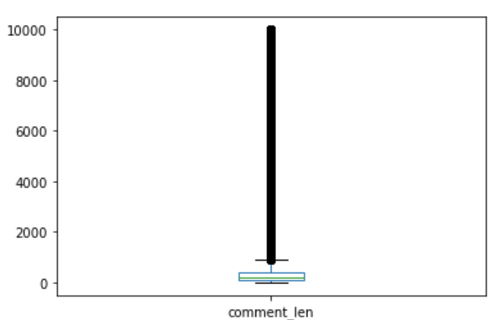

Data cleaning
Search
WIKIPEDIA SET (TRAINING)
Feature engineering
attack: 1 if majority scored 1, else 0
toxicity (1-5): mean score given
aggression (1-7): mean score given
Removal of outliers (mean + 3SD)
Comments that were abnormally long
Notes:
For the Wikipedia comments, each comment was rated by 10 workers, so I had to aggregate the ratings to produce 3 features.
Using these features, I removed several outliers. First, I removed comments that were abnormally long. The longest comments were mostly spam comments consisting of a single repeated word or phrase, which would have severely skewed the word frequencies in a bag of words model. As such, I removed all comments with character lengths above 3 SD of the mean.

Slide 11
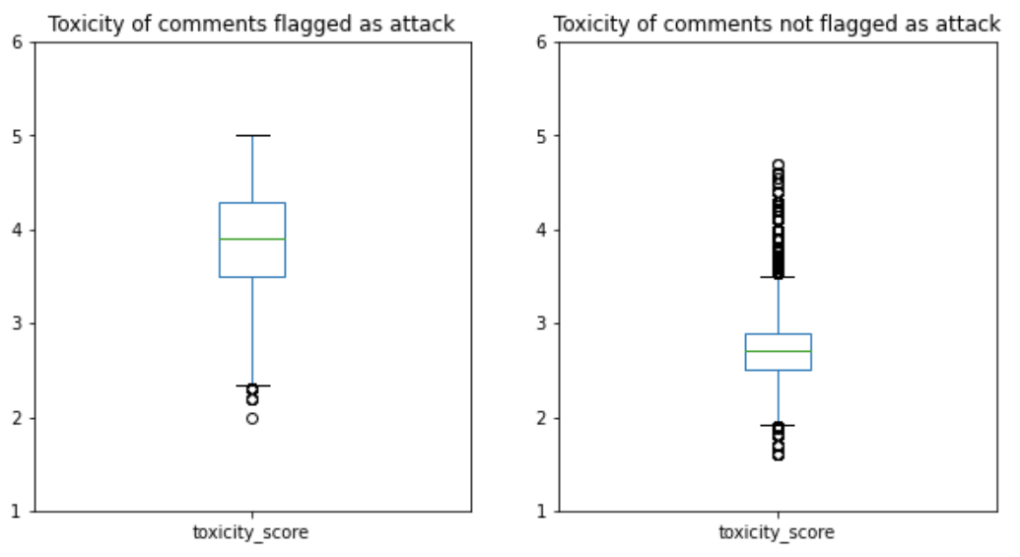
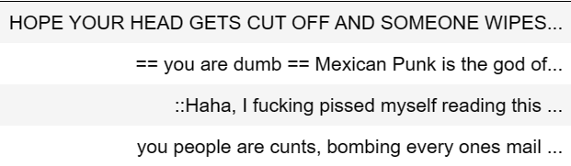
Data cleaning
Search
WIKIPEDIA SET (TRAINING)
Feature engineering
attack: 1 if majority scored 1, else 0
toxicity (1-5): mean score given
aggression (1-7): mean score given
Removal of outliers (mean + 3SD)
Comments that were abnormally long
Comments flagged “attack” but with low toxicity or aggression
Comments flagged “not attack” but with high toxicity or aggression
Undersampling of majority class
Notes:
After that, I removed comments that had “incongruent” ratings, like being rated high in toxicity despite not being flagged as an attack. When I looked into these points, I found comments which seemed to be misclassified. These include unflagged comments like the ones displayed, which I felt should clearly have been flagged as abusive. As such, I removed outliers based on incongruent toxicity or aggression scores.

Slide 12
Data cleaning
Search
WIKIPEDIA SET (TRAINING)
AO3 SET (FINAL TEST)
Remove punctuation
Tokenize
Remove stopwords
Lemmatize
Notes:
After those cleaning steps were applied to the Wikipedia set, I applied the same pre-processing steps to both datasets.

Slide 13
Problem Statement
1
Data Collection & Cleaning
2
Exploratory Data Analysis
3
Modelling & Model Evaluation
4
Conclusions & Recommendations
5

Slide 14

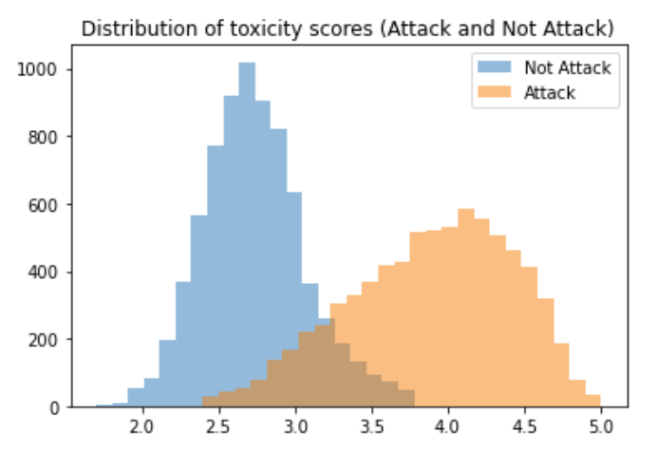
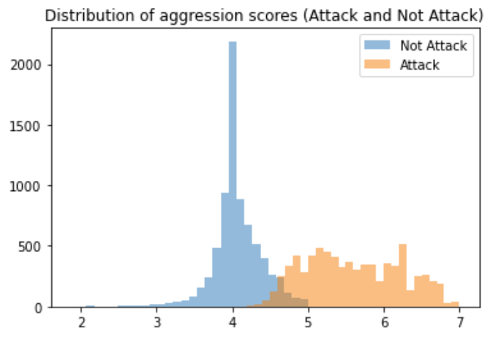
EDA (Wikipedia)
Search
TOXICITY SCORE
Average score of 3.3 with 3 representing “Neither toxic nor healthy”
AGGRESSION SCORE
Average score of 4.8 with 4 representing “Neither aggressive nor friendly”
2.7
Not attack
3.9
Attack
4.1
Not attack
5.6
Attack
Notes:
As expected, comments flagged as attacks were on average higher in toxicity and aggression than unflagged comments.

Slide 15
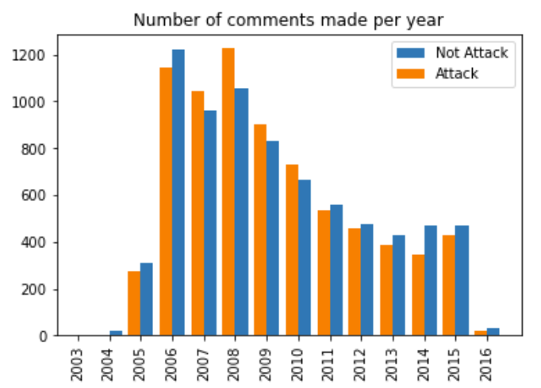
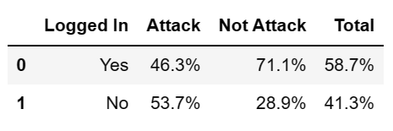
EDA (Wikipedia)
Search
YEAR OF COMMENT
Posted between 2003 to 2016
No difference between attack and not
LOGIN STATUS
Majority of abusive comments were made by anonymous commenters
However, it’s notable that there was still a significant number of logged-in users (46.3%) making abusive comments

Slide 16
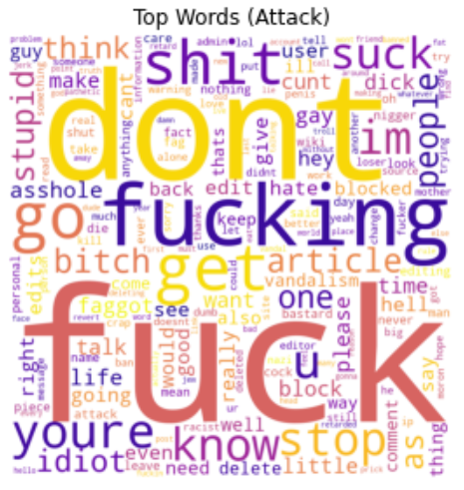
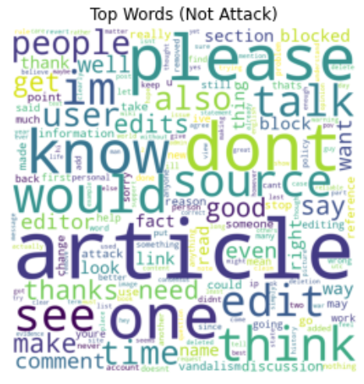
EDA (Wikipedia)
Search
High in profanity
Polite and objective

Slide 17
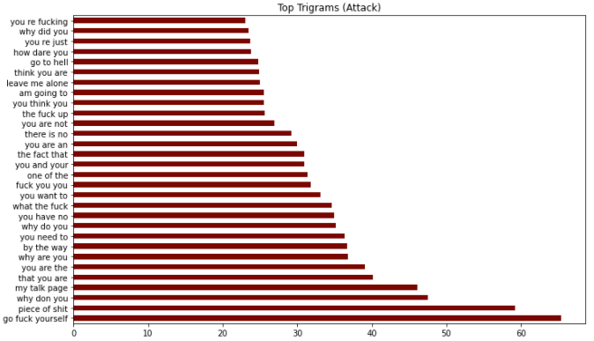
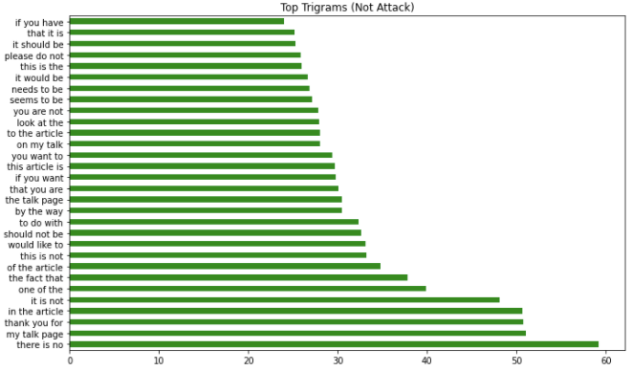
EDA (Wikipedia)
Search
High in profanity
Polite and objective

Slide 18
EDA (Ao3)
Search
AGGRESSORS (TROLLS)
 | Comments | Logged in | Type of comments
Troll 1 | 45 | 69% of the time | Attacks on writing. Low to medium toxicity.
Troll 2 | 30 | Always anon | Violent language . High toxicity.
Troll 3 | 32 | 62% of the time | Insults and hate speech. High toxicity.
Troll 4 | 42 | Always anon | Attacks on writing. Medium toxicity. Sarcasm.
Unknown | 11 | 18% of the time | Mixed
kill urself please
dear author, i hope someone precious to you dies- maybe ur parents?
still i just think you werent bullied enough for being half horse half rat freak bc you still seem to have the nerve to exist. how odd.
kinda amazing that anyone would want to display theyre a hideous middle aged tranny to everyone, but alas
Notes:
Abusive comments in the Ao3 dataset came from 4 known trolls. While collating these comments, I made attempts to ensure that the dataset was not dominated by one troll, so the number of comments from each troll ranged between 30 to 45 comments.
These trolls also had different harassment styles. Trolls 2 and 3 tended to leave highly toxic content that utilized violent language, insults, and hate speech. This included suicide baiting, wishing violence on authors and their families, and targeted transphobic harassment of transgender authors.

Slide 19
EDA (Ao3)
Search
AGGRESSORS (TROLLS)
 | Comments | Logged in | Type of comments
Troll 1 | 45 | 69% of the time | Attacks on writing. Low to medium toxicity.
Troll 2 | 30 | Always anon | Violent language . High toxicity.
Troll 3 | 32 | 62% of the time | Insults and hate speech. High toxicity.
Troll 4 | 42 | Always anon | Attacks on writing. Medium toxicity. Sarcasm.
Unknown | 11 | 18% of the time | Mixed
Felt rushed. But other than that, a pretty okay story :)
Genuinely disgusted EW what the FUCK SHSMS
lol wow love how you completely gutted their personalities to write this! great job! :D :D :D
Fantastic self-insert where you could shove all your favorite pairings together no matter how illogical and change the plot to suit your own fantasies :D
Notes:
Troll 1 tended to make attacks on the writing itself, spamming authors with comments of varying toxicity levels in an attempt to appear like they were multiple different people. For example, the two comments given as examples here were left for the same author, on the same story.
Similar to Troll 1, Troll 4 also tended to make attacks on the writing. But what’s notably different and interesting about this troll is that they make very heavy use of sarcasm, which NLP models often have trouble reading. Compared to Troll 2 and 3, these two trolls generally used less toxic language.

Slide 20
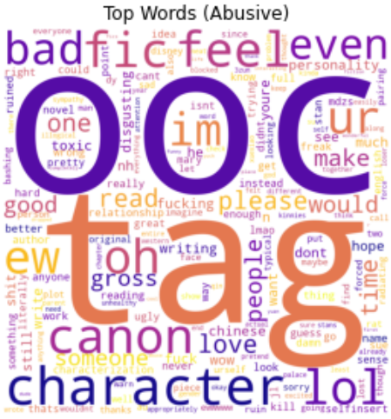
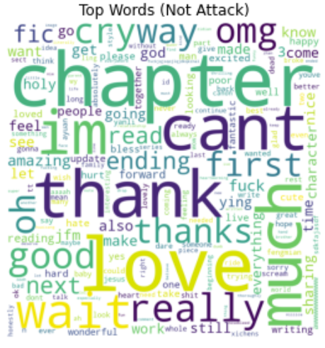
EDA (Ao3)
Search
Fanfiction-specific vocab
Excited and grateful
Notes:
Abusive Ao3 comments do not contain as much profanity, instead containing more fanfiction-specific attacks. This includes use of acronyms like “ooc” which stands for “out of character” which is often used as an attack on an author’s writing ability. Unlike with Wikipedia comments, POSITIVE Ao3 comments seemed to contain more profanity.
It’s likely that abusive comments that contain fanfiction-specific attacks may be misclassified. Positive comments that make use of profanity are also likely to be misclassified in bag of word models.

Slide 21
EDA (Ao3)
Search
AGGRESSORS (TROLLS)
 | Comments | Logged in | Type of comments
Troll 1 | 45 | 69% of the time | Attacks on writing. Low to medium toxicity.
Troll 2 | 30 | Always anon | Violent language . High toxicity.
Troll 3 | 32 | 62% of the time | Insults and hate speech. High toxicity.
Troll 4 | 42 | Always anon | Attacks on writing. Medium toxicity. Sarcasm.
Unknown | 11 | 18% of the time | Mixed
Notes:
In terms of the different kinds of trolling styles, Troll 2 and Troll 3 are probably much more likely to be caught by the abuse classifier, while Troll 1 and Troll 4 are more likely to show up as false negatives due to heavy use of fanfiction-specific attacks, lack of profanity, and in the case of Troll 4, heavy use of sarcasm.

Slide 22
Problem Statement
1
Data Collection & Cleaning
2
Exploratory Data Analysis
3
Modelling & Model Evaluation
4
Conclusions & Recommendations
5

Slide 23
Summary of modelling
Search
VECTORIZERS
LEARNING
BAG OF WORDS
Tf-idf Vectorizer
PYCARET
Logistic regression, Naïve Bayes, SVM, K-Nearest Neighbor, etc.
WORD EMBEDDINGS
GloVE (100 dimensions)
GloVE (300 dimensions)
NEURAL NETWORKS
3 LSTMs
2 CNNs
IN
OUT
BERT
Notes:
My first set of models were vectorized using TF-IDF, and run through PyCaret, which compared the performance of 13 different models, including models like logistic regression, Naïve Bayes, and SVM. From this set of models, I selected the best performing model as a baseline.
After that, I ran a bunch of neural networks trained on word embeddings. I used 100-dimensional and 300-dimensional GloVE embeddings for this purpose, and trained 3 LSTM models, 2 1-Dimensional CNN models, and also tried BERT, a state of the art pre-trained NLP model.

Slide 24
Summary of modelling
Search
VECTORIZERS
LEARNING
BAG OF WORDS
Tf-idf Vectorizer
PYCARET
Logistic regression, Naïve Bayes, SVM, K-Nearest Neighbor, etc.
WORD EMBEDDINGS
GloVE (100 dimensions)
GloVE (300 dimensions)
NEURAL NETWORKS
3 LSTMs
2 CNNs
IN
OUT
BERT
Notes:
I will first cover results and evaluation of the bag of words models.

Slide 25
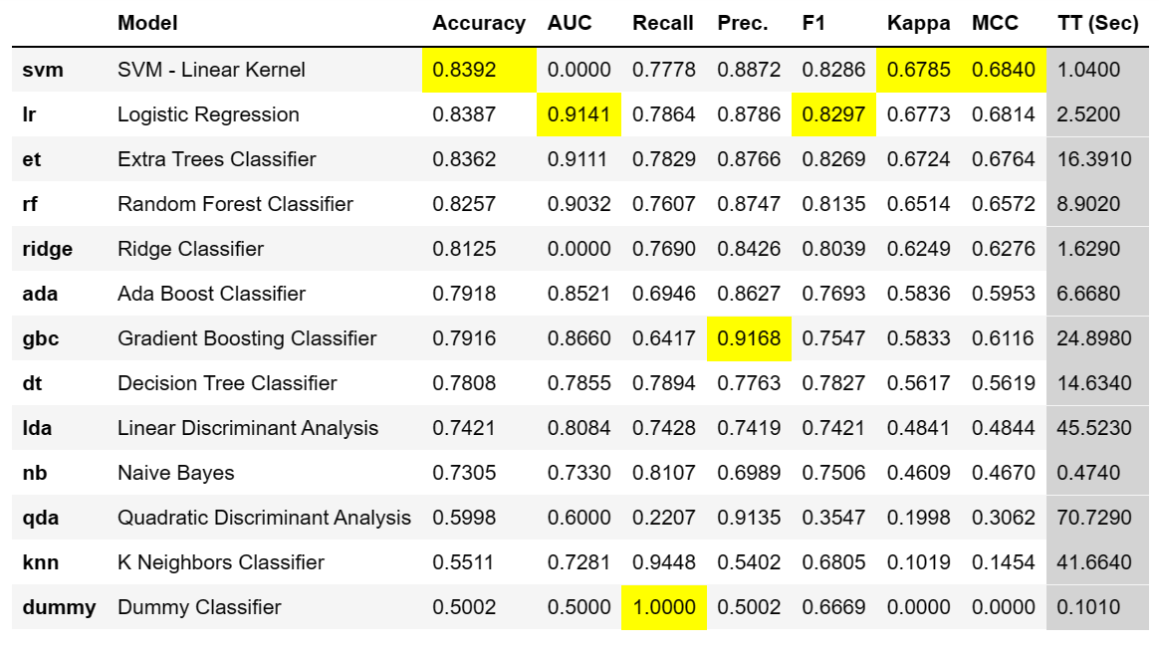
Model Evaluation (Bag-of-Words)
Search
INITIAL MODEL RESULTS
MODEL TUNING
Alpha = 0.0002
L1 ratio = 0.08
Penalty = ElasticNet
 | Train | Test | Ao3
Precision | 88.4% | 89.4% | 59.3%
Recall | 78.3% | 80.5% | 55.6%
Accuracy | 84.0% | 85.5% | 58.8%
Notes:
The SVM model performed best in terms of accuracy, with a decently balanced precision and recall. It also had a shorter training time compared to runner up models like the logistic regression and extra trees classifier. After model tuning, train accuracy rose slightly to 84%. The tuned model performed with a 85.5% accuracy on the test set, but with a much lower accuracy of 58.8% on the Ao3 set.

Slide 26
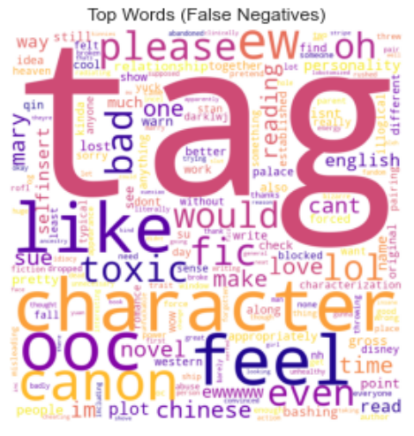
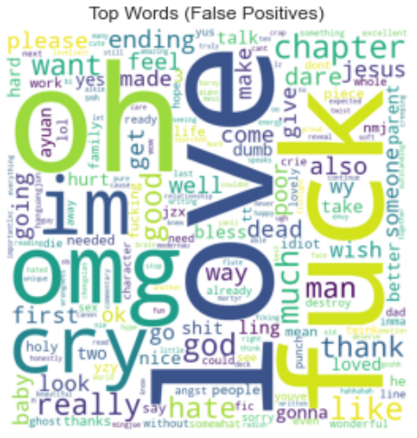
Error Analysis (Bag-of-Words)
Search
Misclassifies abusive comments that isn’t profane but has criticisms that are specific to fanfiction
Misclassifies positive comments that have profanity, or that includes negative comments on an antagonist
Notes:
To get a better sense of the model’s weaknesses, I created word clouds of the top words in wrongly classified comments.

Slide 27
Error Analysis (Bag-of-Words)
Search
“fuck, imma gonna crie”
“oh fuck oh fuck it’s going down and im not ready. we’re about to be massacred with feels”
“CAN SOMEONE FUCKING DECK HIS DAD IN THE FACE OMG HIS DAD IS SUCH A PIECE OF SHIT!!!!”
Misclassifies abusive comments that isn’t profane but has criticisms that are specific to fanfiction
Misclassifies positive comments that have profanity, or that includes negative comments on an antagonist
Notes:
Taking a closer look at what kinds of comments were misclassified, misclassified comments also included positive comments that included NEGATIVE sentiments not about the author, but about a fictional antagonist.

Slide 28
Error Analysis (Bag-of-Words)
Search
AGGRESSORS (TROLLS)
 | Comments | Flagged | Percent | Type of comments
Troll 1 | 45 | 16 | 35.6% | Attacks on writing. Low to medium toxicity.
Troll 2 | 30 | 21 | 70.0% | Violent language . High toxicity.
Troll 3 | 32 | 26 | 81.2% | Insults and hate speech. High toxicity.
Troll 4 | 42 | 21 | 50.0% | Attacks on writing. Medium toxicity. Sarcasm.
Unknown | 11 | 5 | 45.5% | Mixed
Notes:
As predicted, the classifier performed better on trolling styles that were highly toxic and utilized profane and violent language, or hate speech. In comparison, it did more poorly on trolls who tended to use more fandom-specific attacks, or who were more sarcastic.

Slide 29
Summary of modelling
Search
VECTORIZERS
LEARNING
BAG OF WORDS
Tf-idf Vectorizer
PYCARET
Logistic regression, Naïve Bayes, SVM, K-Nearest Neighbor, etc.
WORD EMBEDDINGS
GloVE (100 dimensions)
GloVE (300 dimensions)
NEURAL NETWORKS
3 LSTMs
2 CNNs
IN
OUT
BERT
Notes:
I was quite excited to test the effects of deep learning on abuse classification as deep learning models are usually said to be able to overcome some of the weaknesses in bag-of-words models. Setting my previously optimized SVM as a baseline to evaluate the deep learning models, I trained 3 LSTMS, 2 CNNS, and also trained a BERT model.

Slide 30
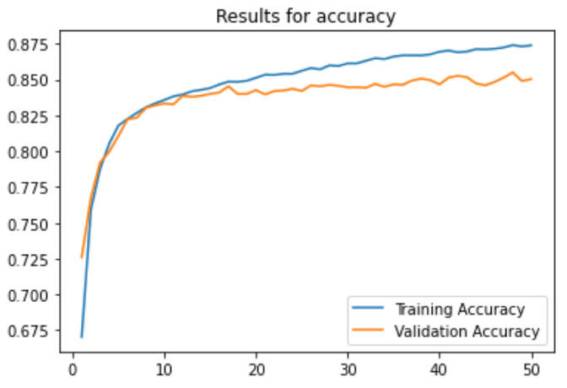
Model Evaluation (LSTMs)
Search
LSTM with GloVE 100d
100-dimensional GloVE
LSTM layer with 10 nodes
Trained to 17th epoch
Notes:
The first model I tried was a LSTM model with 10 nodes, using 100-dimensional GloVE embeddings. Because the learning curve showed signs of overfitting when trained to the 50th epoch, I decided to retrain the model, stopping at the 17th epoch instead.

Slide 31
Model Evaluation (LSTMs)
Search
LSTM with GloVE 100d
100-dimensional GloVE
LSTM layer with 10 nodes
Trained to 17th epoch
 | Train | Test | Ao3
Precision | 86.3% | 87.1% | 65.1%
Recall | 83.8% | 80.5% | 60.6%
Accuracy | 85.2% | 84.3% | 64.1%
Baseline accuracy | 84.0% | 85.5% | 58.8%
Notes:
The resulting model outperformed the baseline Bag-of-words SVM model on the train and ao3 datasets. I was personally quite excited by getting a 64% accuracy on the ao3 set on first try.

Slide 32
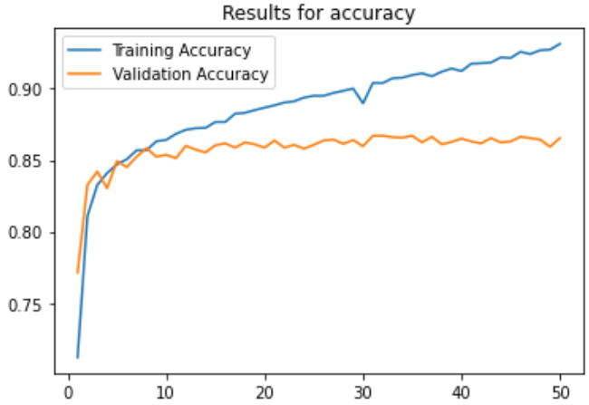
Model Evaluation (LSTMs)
Search
LSTM with GloVE 100d
100-dimensional GloVE
LSTM layer with 10 nodes
Trained to 17th epoch
LSTM with GloVE 300d
300-dimensional GloVE
LSTM layer with 24 nodes
Trained to 8th epoch
 | Train | Test | Ao3
Precision | 86.3% | 87.1% | 65.1%
Recall | 83.8% | 80.5% | 60.6%
Accuracy | 85.2% | 84.3% | 64.1%
Baseline accuracy | 84.0% | 85.5% | 58.8%
Notes:
In an attempt to boost the performance of the model, I trained a second LSTM model on 300-dimensional GloVE embeddings, this time with 24 nodes. The overfitting was even more pronounced for this model when train to the 50th epoch, so I had to stop training at the 8th epoch.

Slide 33
Model Evaluation (LSTMs)
Search
LSTM with GloVE 100d
100-dimensional GloVE
LSTM layer with 10 nodes
Trained to 17th epoch
LSTM with GloVE 300d
300-dimensional GloVE
LSTM layer with 24 nodes
Trained to 8th epoch
 | Train | Test | Ao3
Precision | 86.3% | 87.1% | 65.1%
Recall | 83.8% | 80.5% | 60.6%
Accuracy | 85.2% | 84.3% | 64.1%
Baseline accuracy | 84.0% | 85.5% | 58.8%
 | Train | Test | Ao3
Precision | 89.7% | 87.1% | 63.3%
Recall | 84.3% | 80.7% | 50.6%
Accuracy | 87.3% | 85.1% | 60.6%
Baseline accuracy | 84.0% | 85.5% | 58.8%
Notes:
The resulting model again outperformed the baseline Bag-of-words model on the train and ao3 datasets. Unfortunately, the performance on the Ao3 set dropped in relation to the first model.

Slide 34
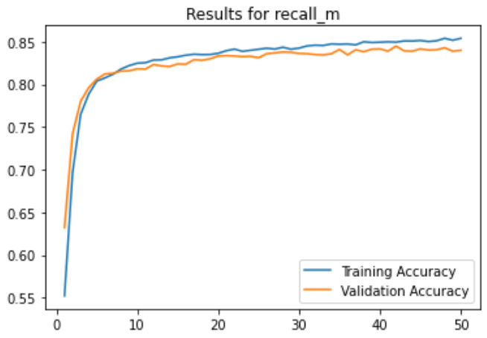
Model Evaluation (LSTMs)
Search
LSTM with GloVE 100d
100-dimensional GloVE
LSTM layer with 10 nodes
Trained to 17th epoch
LSTM with GloVE 300d
300-dimensional GloVE
LSTM layer with 24 nodes
Trained to 8th epoch
Bi-LSTM with GloVE 100d
100-dimensional GloVE
Bi-LSTM layer with 10 nodes
L2 weights regularization
 | Train | Test | Ao3
Precision | 86.3% | 87.1% | 65.1%
Recall | 83.8% | 80.5% | 60.6%
Accuracy | 85.2% | 84.3% | 64.1%
Baseline accuracy | 84.0% | 85.5% | 58.8%
 | Train | Test | Ao3
Precision | 89.7% | 87.1% | 63.3%
Recall | 84.3% | 80.7% | 50.6%
Accuracy | 87.3% | 85.1% | 60.6%
Baseline accuracy | 84.0% | 85.5% | 58.8%
Notes:
This led to the creation of a third model. I thought that it was possible that the second model was overfitting due to having too many dimensions and hidden nodes. As such, I went back to using 100-dimensional GloVE embeddings and reduced the number of nodes back to 10. I also applied L2 regularization on the weights in the LSTM layer to further reduce overfitting, and used a Bidirectional LSTM layer, which I hoped would boost model performance.

Slide 35
Model Evaluation (LSTMs)
Search
LSTM with GloVE 100d
100-dimensional GloVE
LSTM layer with 10 nodes
Trained to 17th epoch
LSTM with GloVE 300d
300-dimensional GloVE
LSTM layer with 24 nodes
Trained to 8th epoch
Bi-LSTM with GloVE 100d
100-dimensional GloVE
Bi-LSTM layer with 10 nodes
L2 weights regularization
 | Train | Test | Ao3
Precision | 86.3% | 87.1% | 65.1%
Recall | 83.8% | 80.5% | 60.6%
Accuracy | 85.2% | 84.3% | 64.1%
Baseline accuracy | 84.0% | 85.5% | 58.8%
 | Train | Test | Ao3
Precision | 89.7% | 87.1% | 63.3%
Recall | 84.3% | 80.7% | 50.6%
Accuracy | 87.3% | 85.1% | 60.6%
Baseline accuracy | 84.0% | 85.5% | 58.8%
 | Train | Test | Ao3
Precision | 83.7% | 83.5% | 58.6%
Recall | 88.3% | 84.8% | 59.4%
Accuracy | 85.6% | 84.0% | 58.8%
Baseline accuracy | 84.0% | 85.5% | 58.8%
Notes:
However, this didn’t really translate into particularly good model performance.

Slide 36
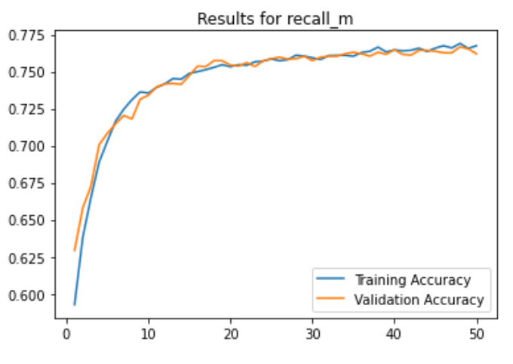
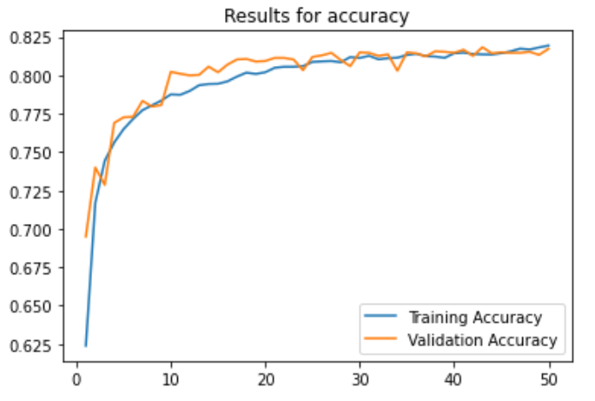
Model Evaluation (CNNs)
Search
1D CNN with GloVE 100d
1D CNN with GloVE 300d
 | Train | Test | Ao3
Precision | 79.2% | 79.7% | 51.9%
Recall | 72.7% | 70.3% | 52.5%
Accuracy | 76.8% | 76.2% | 51.9%
Baseline accuracy | 84.0% | 85.5% | 58.8%
 | Train | Test | Ao3
Precision | 80.7% | 81.9% | 60.7%
Recall | 83.2% | 81.4% | 63.7%
Accuracy | 81.6% | 81.7% | 61.3%
Baseline accuracy | 84.0% | 85.5% | 58.8%
Notes:
Although CNNs tend to be associated with computer vision rather than NLP tasks, the literature suggests that 1-dimensional CNNs can be utilized for abuse detection tasks. I thus trained two models, one on 100-dimensional and one on 300-dimensional GloVE embeddings. There was less overfitting for these models, but the model performance was quite far below the baseline for the train and test, so I did not experiment further.

Slide 37
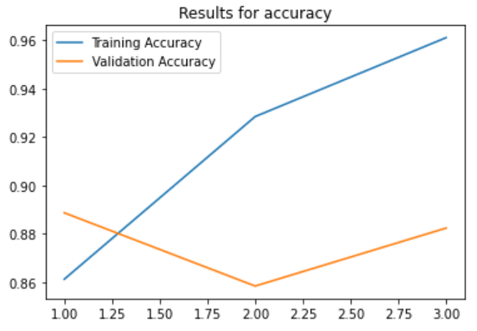
Model Evaluation (CNNs & BERT)
Search
1D CNN with GloVE 100d
1D CNN with GloVE 300d
BERT
 | Train | Test | Ao3
Precision | 79.2% | 79.7% | 51.9%
Recall | 72.7% | 70.3% | 52.5%
Accuracy | 76.8% | 76.2% | 51.9%
Baseline accuracy | 84.0% | 85.5% | 58.8%
 | Train | Test | Ao3
Precision | 80.7% | 81.9% | 60.7%
Recall | 83.2% | 81.4% | 63.7%
Accuracy | 81.6% | 81.7% | 61.3%
Baseline accuracy | 84.0% | 85.5% | 58.8%
 | Train | Test | Ao3
Precision | 98.7% | 87.4% | 60.4%
Recall | 99.1% | 89.3% | 54.4%
Accuracy | 98.9% | 88.2% | 59.4%
Baseline accuracy | 84.0% | 85.5% | 58.8%
Notes:
Finally, the last model I tried was BERT, which is a state of the art pre-trained model used for NLP tasks. According to the literature, BERT only needs to be trained for 1 to 3 epochs, so I trained BERT on the Wikipedia comments for 3 epochs. While the train and test performance was the best amongst all the models, the scores and learning curves suggest that I may have overtrained the model. It would probably have been better to train for only 1 epoch.
It was a pity to see that BERT did not perform so well on the Ao3 set. With a large enough set of Ao3 comments to train it on, BERT would probably have worked well.

Slide 38
Model Evaluation (NNs)
Search
LSTM with GloVE 100d
LSTM with GloVE 300d
Bi-LSTM with GloVE 100d
 | Train | Test | Ao3
Precision | 86.3% | 87.1% | 65.1%
Recall | 83.8% | 80.5% | 60.6%
Accuracy | 85.2% | 84.3% | 64.1%
Baseline accuracy | 84.0% | 85.5% | 58.8%
 | Train | Test | Ao3
Precision | 89.7% | 87.1% | 63.3%
Recall | 84.3% | 80.7% | 50.6%
Accuracy | 87.3% | 85.1% | 60.6%
Baseline accuracy | 84.0% | 85.5% | 58.8%
 | Train | Test | Ao3
Precision | 83.7% | 83.5% | 58.6%
Recall | 88.3% | 84.8% | 59.4%
Accuracy | 85.6% | 84.0% | 58.8%
Baseline accuracy | 84.0% | 85.5% | 58.8%
1D CNN with GloVE 100d
1D CNN with GloVE 300d
BERT
 | Train | Test | Ao3
Precision | 79.2% | 79.7% | 51.9%
Recall | 72.7% | 70.3% | 52.5%
Accuracy | 76.8% | 76.2% | 51.9%
Baseline accuracy | 84.0% | 85.5% | 58.8%
 | Train | Test | Ao3
Precision | 80.7% | 81.9% | 60.7%
Recall | 83.2% | 81.4% | 63.7%
Accuracy | 81.6% | 81.7% | 61.3%
Baseline accuracy | 84.0% | 85.5% | 58.8%
 | Train | Test | Ao3
Precision | 98.7% | 87.4% | 60.4%
Recall | 99.1% | 89.3% | 54.4%
Accuracy | 98.9% | 88.2% | 59.4%
Baseline accuracy | 84.0% | 85.5% | 58.8%
Notes:
In the end, after 2 days of frantic modelling, the first model I did was the one that performed the best on Ao3 comments.

Slide 39
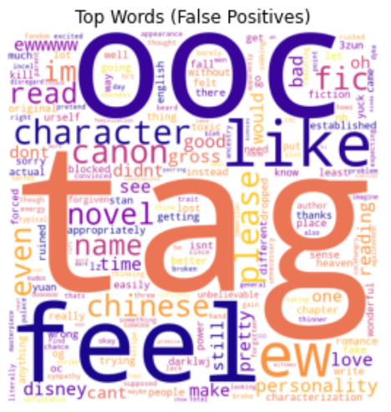
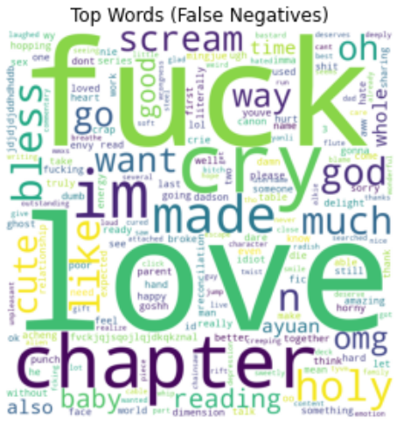
Error Analysis (LSTM)
Search
Still misclassifies abusive comments that has criticisms that are specific to fanfiction
Still misclassifies positive comments that contain profanities

Slide 40
Error Analysis (LSTM)
Search
AGGRESSORS (TROLLS)
 | Comments | Base | LSTM | Type of comments
Troll 1 | 45 | 35.6% | 35.6% | Attacks on writing. Low to medium toxicity.
Troll 2 | 30 | 70.0% | 70.0% | Violent language . High toxicity.
Troll 3 | 32 | 81.2% | 81.2% | Insults and hate speech. High toxicity.
Troll 4 | 42 | 50.0% | 64.4% | Attacks on writing. Medium toxicity. Sarcasm.
Unknown | 11 | 45.5% | 72.7% | Mixed
Notes:
It appears that the model did better at identifying abusive comments from Troll 4 and from the mixed bag of unknown abusive commenters.

Slide 41

Error Analysis (LSTM)
Search
Model doesn't do well on positive comments that contain profanity
“that was fucking amazing! thank you!” – 0.8757
Model does decently on sarcastic comments
“amazingly illogical and senseless! good job!“ – 0.8310
But model is sensitive to typos - prediction changed quite drastically
“amazingly ilogical and senseless! good job!“ – 0.6574
Model doesn't do well with negative vocabulary that it wasn't trained on
“amazingly ooc! good job!” – 0.1783

Slide 42
Problem Statement
1
Data Collection & Cleaning
2
Exploratory Data Analysis
3
Modelling & Model Evaluation
4
Conclusions & Recommendations
5

Slide 43
Conclusions & Recommendations
Search
Achieved baseline accuracy of 58.8% with SVM and tf-idf vectorization
LSTM model outperformed baseline model with accuracy of 64.1%
Model doesn't do well on positive comments that contain profanity
Model doesn't do well with vocabulary that it wasn't trained on
Model is sensitive to typos - prediction changed quite drastically
Can be helped by using character-level rather than word-level embeddings.
Can’t be helped. Requires more tailored training content.
Choose better dataset to train on
Label Ao3 data
Notes:
The LSTM model was able to outperform the baseline model, but is subject to a number of key weaknesses.
According to the literature, this last weakness can likely be helped by using character-level rather than word-level embeddings with a 1D CNN. However, the other two weaknesses will likely require tailored training data to improve. There are two options available. Either we can attempt to choose a better dataset to train on, which would be difficult because fanfiction-terms can be very specific, or we can collect and label Ao3 comments to create a train dataset. The second option, while time-consuming, is likely to lead to better performance.

Slide 44
Conclusions & Recommendations
Search
1
2
3
More advanced models
Deep learning models implemented are relatively shallow models
Try deeper layers, hybrid models, better architecture
Try tailored pre-trained models like HateBERT
Choose better train data
Style of conversation and typing is more formal on Wikipedia than on Ao3
Try to find train data that better matches the writing style and vocabulary used on Ao3
This is potentially difficult
Collect and label Ao3 data
Best way is to integrate a data collection system into the platform and let users flag content for you – but this requires action from the platform managers
If manually labelled, it will be manpower intensive, but will probably lead to the best performance
Notes:
Recommendations are organized into three main types.

